Slide 1
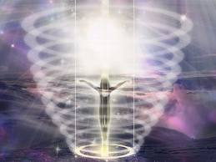
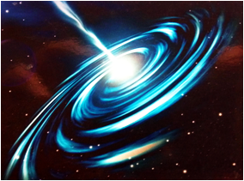
Science of Law of Attraction
Science of Spiritual Beings of Light Lectures
Presented at Unity Church of Dallas
Oct 24, 31 - Nov 7, 14, 2011
By Doug Matzke, Ph.D.
Doug@QuantumDoug.com

Slide 2
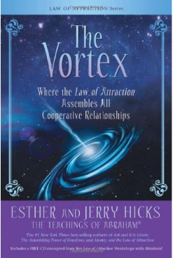
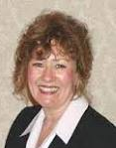

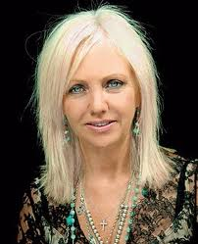

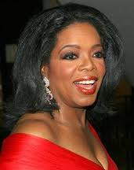
Law of Attraction History
Brief History of Law of Attraction:
Ancient ideas from secret societies
Focused on by Ester & Jerry Hicks
Ester is channel for being ‘Abraham’
Ester included in the movie ‘The Secret’
Secret ideas/movie liked by Oprah
‘The Secret’ reissued without Ester
‘The Secret behind the Secret’ released
Abraham/Ester speaks all over world
LOA popular with hundreds of CDs/books
Large overlap with other domains

Slide 3
Presuppositions of LOA
Presuppositions of Law of Attraction:
Humans are eternal vibrational beings having a physical experience
Abraham’s insights are beyond human perspective
Law of Attraction is primary principle for inclusion based universe
This principle is source creative intelligence and creator of worlds
Law of Attraction rules are shared but Physics of LOA is not revealed
Like attracts Like – where ‘Not X’ is still attracting ‘X’
Everything is intelligence and thought vibrations
Thoughts, emotions & energy are tied together and synergistic
Thoughts extend beyond the physical/classical brain/body
Thoughts are ‘things’ that affect the world
Thoughts include conscious, unconscious, beliefs and body states
You are responsible for creating your own reality
Law of Attraction works whether you believe it or not
Teachings’ purpose is how to become focused deliberate creators

Slide 4
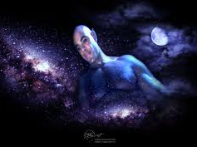
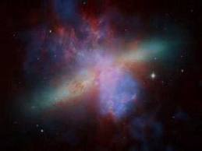
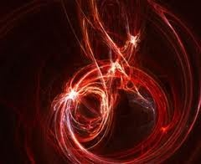
Who/What is Abraham?
Spiritual Entity channeling thru Ester
Abraham is “We” or multi-being
Abraham represents ‘Infinite Intelligence’
Represents non-human perspective for us
Language patterns as non-native speaker
Message is enlightening & entertaining
Message is extremely self consistent
Message contains technical information
Abraham has energetic presence
Collectively we are leading edge of Source

Slide 5

Law of Attraction Overview
LOA topics related to Science of Spiritual Beings:
Vibrational thoughts create reality
  Source mechanism that creates worlds
  Be aware of and focus your thoughts
  People cancel their goals with unresourceful thoughts
  Deliberate focused intention for deliberate creation
  Requires mechanism connecting thought to meaning
Memory/Thoughts are related to emotions
  Emotion affects memories and decisions
  Energized thoughts amplifies Law of Attraction
  Model of Emotional maturity ladder – goal is relief
  Requires model connecting thoughts and emotions
Vortex represents preferred & focused thoughts/emotions
  Goal is to spend more time in ‘good vortex’ rather than ‘bad rut’
  Cooperative components are assembled
  Attracts components using non-local non-classical mechanisms

Slide 6

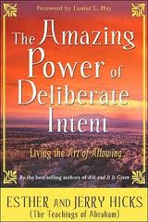
Simple Steps for Art of Allowing
‘Ask & It Is Given’ Process (the 3 As):
Ask [Your Work]
  ‘Rockets of Desire’ are always going out to world
Answer is Given [Not Your Work]
  Your vibrational asking affects thought reality
Allow it to happen [Your Work]
  Allow and expect it to happen quickly
Become a deliberate creator

Slide 7
Fine Tuning Asking & Allowing
Fine Tuning Step 1: Asking Vibrationally
Focus on what you want (not the lack of it)
Choose Go-To strategy rather than Away-From strategy
Specified well formed outcomes with right amount of details
Make asking real (using images, sounds, symbols & feelings)
Imagine as if you already have it (not in the future)
Energize the asking with positive emotions
Ground, clear obstacles and remove distractions (mental and energetic)
Fine Tuning Step 3: Allowing Vibrationally
Answering happens outside of time so expect quick results
Positive emotion is the building block of vibrational allowing
Stop focusing on beliefs that attract wrong items (i.e. original problem)
Thoughts of disbelief cancel the Asking (‘This will never happen’, etc)
Share successes and ‘lucky coincidences’ that are manifestation matches
Don’t share with people who disbelieve

Slide 8
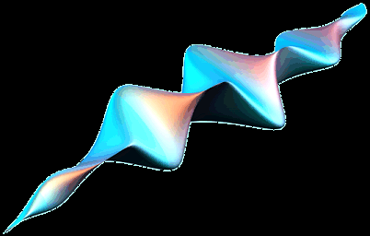
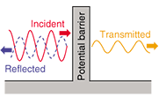
Vibration and Law of Attraction
Frequency vs. vibration
Light (E/M Wave)
Sound (Music, Applause)
Succussion, applause
Gravity, space-time ripples
Probability Amplitude
Thoughts/Rotes
Beings of Light are quantum vibrational beings

Slide 9
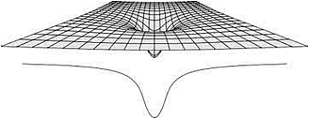
What is The Vortex?
Dominant thought patterns keep building
Deliberate positive escrow account
Feeling good is important component
Rockets increase mass/energy/bits of vortex
Acts as resource anchor for living/manifestation
Reticular activating system helps make matches
Cooperative components are non-local yet ‘near’
Vortex is meaning related high dim. state space

Slide 10

Inclusion Based Universe
Each dimension is own meaning (vibration)
Each Dimension represents both X and Not X
Not X ≠ Y
Quantum state space
X
90⁰
Not Y
Y
Not X
This is quantum State Space used by Light

Slide 11
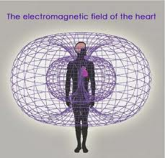
Biology and Law of Attraction
  Body, Heart, Brain and Mind states
Vortex supported by Biological state space
  Neuron vibrations represent address
  Emotional state effects brain states
  Reticular activating system is biased
Heart is dominant physical factor
  Electromagnetic field is state space
  Largest state space from body
  Heart Intelligence and heart chakra
Physical Body is not the full picture

Slide 12


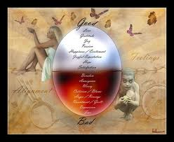
Emotions and Law of Attraction
Physical Side of Emotions
  Affects memory & body state chemistry
Meta-Physical Side of Emotions
  Feeling bad closes chakras
  Appreciation opens chakras
  Increased chi energy flow
  Alignment builds energy
  Supercharge emotional body
  Supercharge astral body

Slide 13
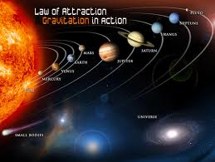
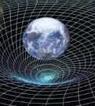

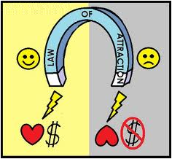
Law of Attraction as Physics?
Attraction Information Properties
  Likeness = Nearness
  Address is Meaning
  Attraction is like gravity wells
  Attraction is monopole ➔
  Polarity is Energy Centric
Dimensional Inclusion
  Dimensions are bits & complexity
  Inclusion of semantics/meaning
  Semantic network topologies

Slide 14
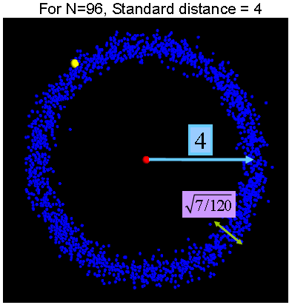
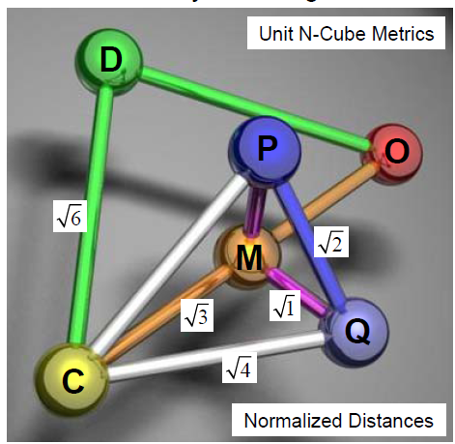

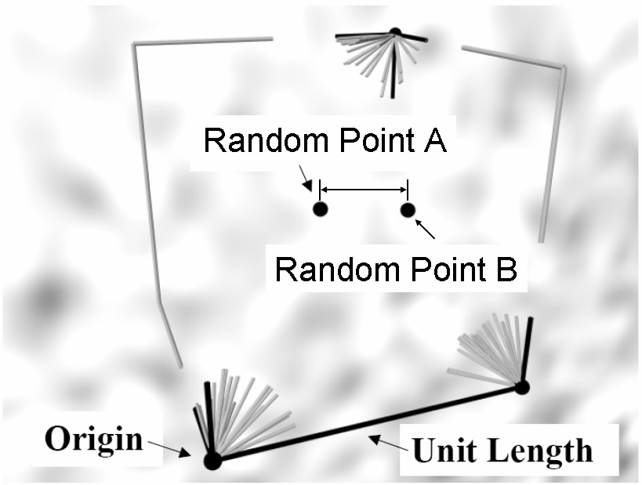
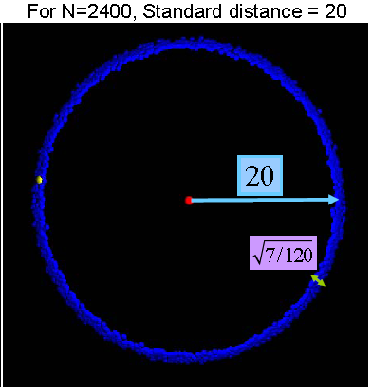
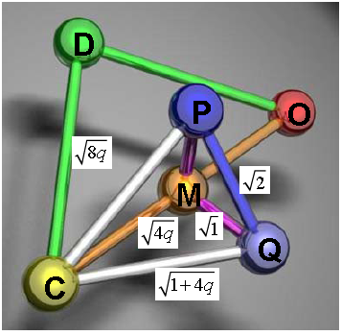

Math of Thought Dimensions
Thought Point A
Thought Point B
Quantum Topology
Corner?
inclusion box

Slide 15
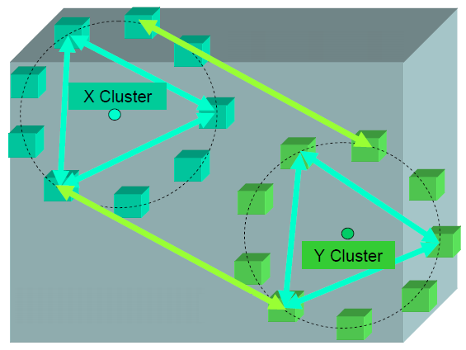


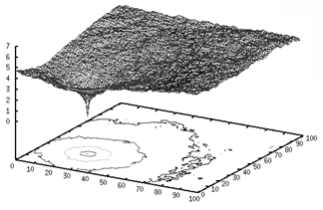
Vortices and Thought Mass/Energy/Bits
Like thoughts are semantically ‘near’ each other in localized clusters of ‘like’ thoughts

Slide 16
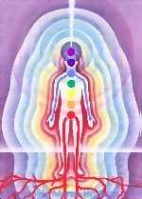
Quantum Mind Model
Thoughts are dimensional strands of source
  State space is outside of 4D spacetime
  Very high dimensional state space
  Randomness is key resource
  Quantum style orthogonal states
  Probabilistic state combination
  CDMA style computational framework
  Dimensional increase due to superposition/entanglement
  Semantic relations exist & can be constructed
  Brain/mind mapping using phase invariance (patent)

Slide 17
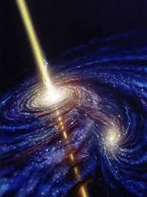
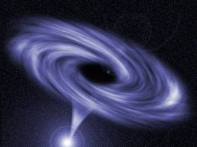
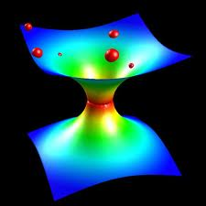
Thoughts are Quantum Things
Thoughts are ‘Things’
Information is Physical
Wheeler’s ‘It From Bit’
Thoughts affect probabilities
Thoughts have an effective mass/energy
Source that creates worlds

Slide 18
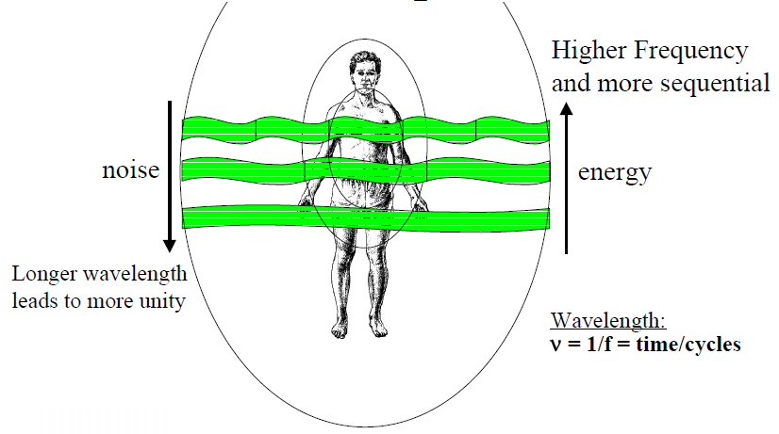
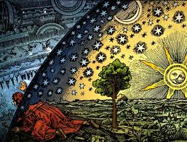
Quantum Mind Paradoxical Metrics
Wavelength determines Size of Now Bubble

Slide 19

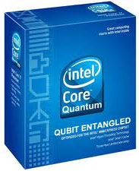

Manifestation
Thought forms source precedes everything
  Exist in quantum protophysical space-time.
Hold a single pure thought for 17 seconds
  equivalent to 2000 hours of action
Doubles every 17 seconds (as much as 10X)
  17 secs is worth 2,000 man hours (or 2,000)
  34 secs is worth 4,000 man hours (or 20,000)
  51 secs is worth 8,000 man hours (or 200,000)
  68 secs is worth 16,000 man hours (or 2,000,000)
This doubling is leverage of quantum math
  Shor’s Algorithm relies on this same leverage
Energize thoughts with appreciation, joy & love
  Connects the quantum space to physical body

Slide 20

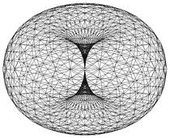

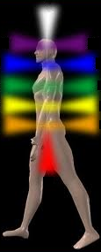
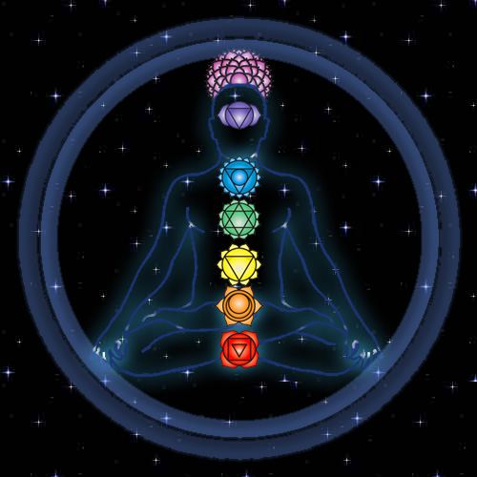
Vortex Building Meditation

Slide 21
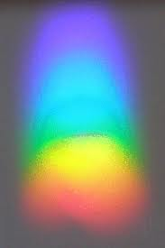
Questions and Discussion
Possible Discussion Topics:
Larger part of you is inner being that evolves
Rampage of appreciation
More on Vibration
Joyous creator
Group thought
Focus and observer frames
Law as equations
…

Slide 22
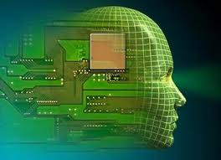
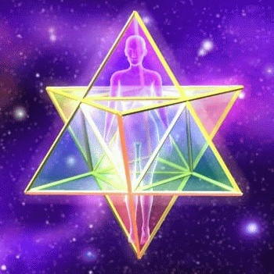
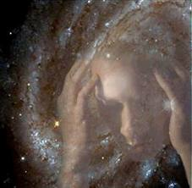
Science of Spiritual Beings Series
Oct 24: Introduction to Science of Spiritual Beings
Oct 31: Science of Law of Attraction
Nov 7: Science of Thoughts, Beliefs, Emotions and Subtle Energy
Nov 14: Science of Daily Living as Spiritual Beings both now and in the future

